Slide 1
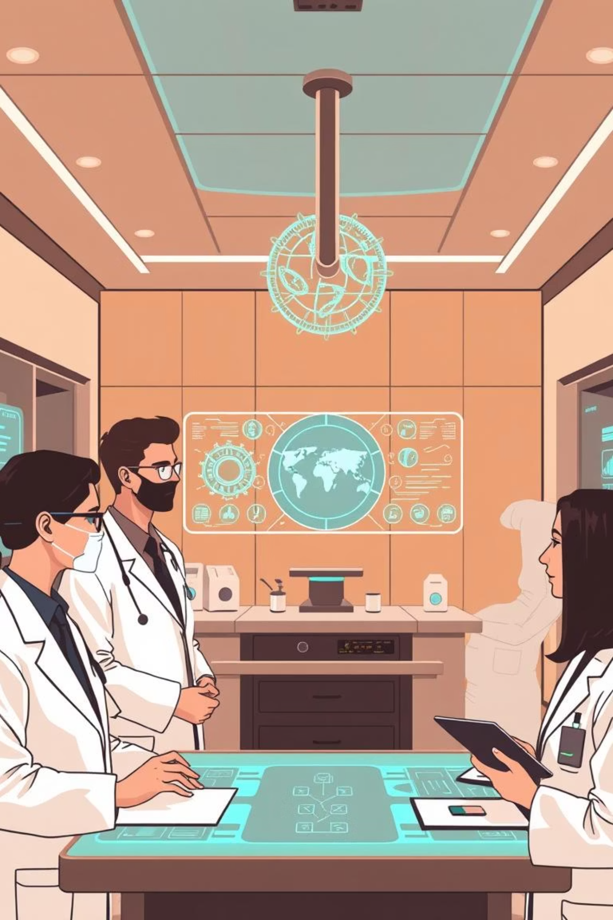
InfoMed AI: Your Trusted Health Ally
Reimagining Healthcare in the Age of Information
DATAQUEST 2.0 | Team 79

Slide 2
The Problem: A Crisis of Trust and Health
The search for reliable health information is failing. Eighty percent of adults seek answers online, only to face a dangerous "infodemic" that undermines well-being and overloads healthcare systems.
Widespread Misinformation
Dangerous Health Outcomes
System Overload
During an outbreak, up to 87% of public social media content is false, fueling panic and eroding trust in science.
Confusion leads to delayed treatment, poor health choices, and accelerated disease spread.
Preventable illness and patient anxiety place an immense, unsustainable burden on our healthcare infrastructure.

Slide 3

Our Solution: Accessible, Verified Guidance, 24/7
InfoMed AI: Your AI-Powered Health Ally
We deploy InfoMed AI, an AI-powered health ally designed to deliver the right information at the right time. Our platform provides every user with an intuitive, interactive resource, cutting through the noise with verified guidance when it matters most. We are moving from information chaos to a single source of truth.

Slide 4
How It Works: Engineered for Trust
Our methodology is built on a four-pillar framework to ensure unparalleled reliability and accuracy.
01
02
Verified Data Ingestion
Intelligent Knowledge Graph
We source data exclusively from premier global authorities like the WHO and CDC. No exceptions.
Data is structured into a sophisticated model that maps symptoms, conditions, and medically-sound next steps.
03
04
Intuitive User Experience
Continuous Optimization
A conversational interface designed for simplicity and accessibility, ensuring anyone can get clear answers quickly.
Rigorous performance monitoring and model updates post-launch maintain peak accuracy and relevance.

Slide 5
Our Competitive Advantage: A Specialized Focus
Generalist tools cannot solve a specialist problem. Our dedicated focus is our strategic advantage over existing alternatives.
General AI (LLMs)
Basic Health Bots
InfoMed AI
Powerful but non-specialized tools that rely on unverified public data and lack clinical guardrails for safe health guidance.
Limited to simple, pre-scripted Q&A. Purely reactive and lack proactive capabilities or deep integration.
A purpose-built system combining clinically vetted knowledge for trusted answers, proactive community alerts, and deep integration with local health systems.

Slide 6
Our Roadmap: From Ally to Ecosystem
Our vision extends beyond answers to full-circle health support.
Phase 1: Expanding Community Reach
1
Multilingual Support: Breaking language barriers to serve diverse populations.
2
Phase 2: Deepening Patient Integration
Proactive Outbreak Alerts: Delivering geo-targeted notifications for local health trends.
Personalized Health Education: Tailoring content to improve individual health literacy.
Local Health Directory: Integrating with local systems to map nearby clinics and pharmacies.
Administrative Automation: Simplifying appointment scheduling and prescription refills.

Slide 7
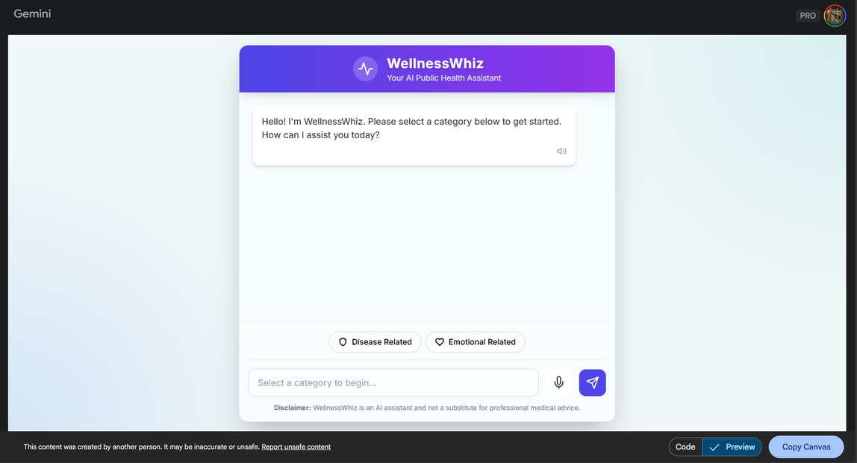
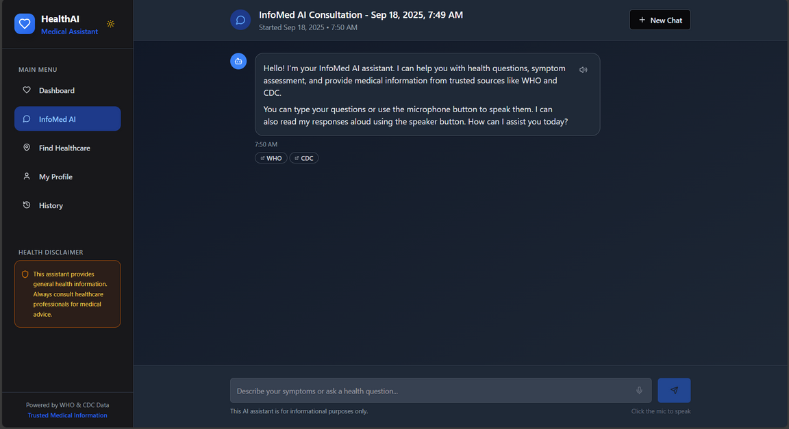
BEFORE
AFTER

Slide 8
Projected Impact: Measurable Health Outcomes
Our success will be defined by tangible, data-driven results.
70%
50%
30%
Empowering Individuals
Combating Misinformation
Increasing Healthcare Efficiency
Increase public health literacy and confident decision-making, measured through user engagement and sentiment analysis.
Establish a primary source of truth, measurably reducing the reach of harmful narratives online.
Decrease the load on non-urgent services, allowing healthcare professionals to focus on critical care.
These are projected impacts, actual results may vary based on adoption and implementation.

Slide 9
LIMITATIONS:-
Cannot replace the clinical judgement, physical examination and
empathetic connection of a qualified human healthcare professional
Accountability and Liability
Data privacy

Slide 10
FUTURE SCOPE:-
Make it more Accessible
Scalabilty
Greater Personliization
Enhanced emotional intelligence
Seamless Integration

Slide 11
Summary: Redefining Health Information
"The future of healthcare is intelligent, accessible, and built on trust. InfoMed AI is leading the way."
The Crisis
Our Solution
Our Future
Widespread misinformation is a direct threat to public health, leading to poor outcomes and system overload.
InfoMed AI, an accessible and trusted AI health ally built on a foundation of verified data.
A fully integrated health partner that empowers individuals and strengthens community-wide health.

Slide 12

Thank You
Questions & Discussion
Our Team: Viransh Jain (25BCE1371) | Aniket Phadke (25BCE1352) | Pranit Nitin Bhosale (25BCE1236) | Prasham Girish Hodlur (25BCE1515) | Udit Kumar Sahoo (25BCE1376)

Slide 13


Let's build a healthier, better-informed future together.
https://health-ai-assistant-copy-d1c956c4.base44.app

